Slide 1
Database design basics

Slide 2
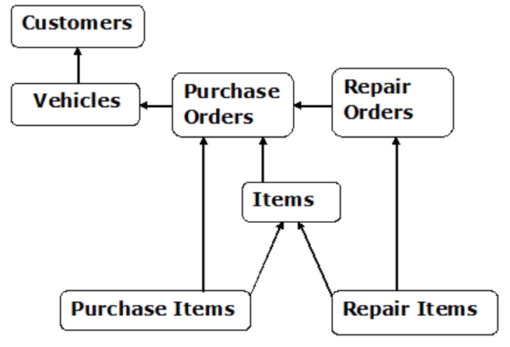
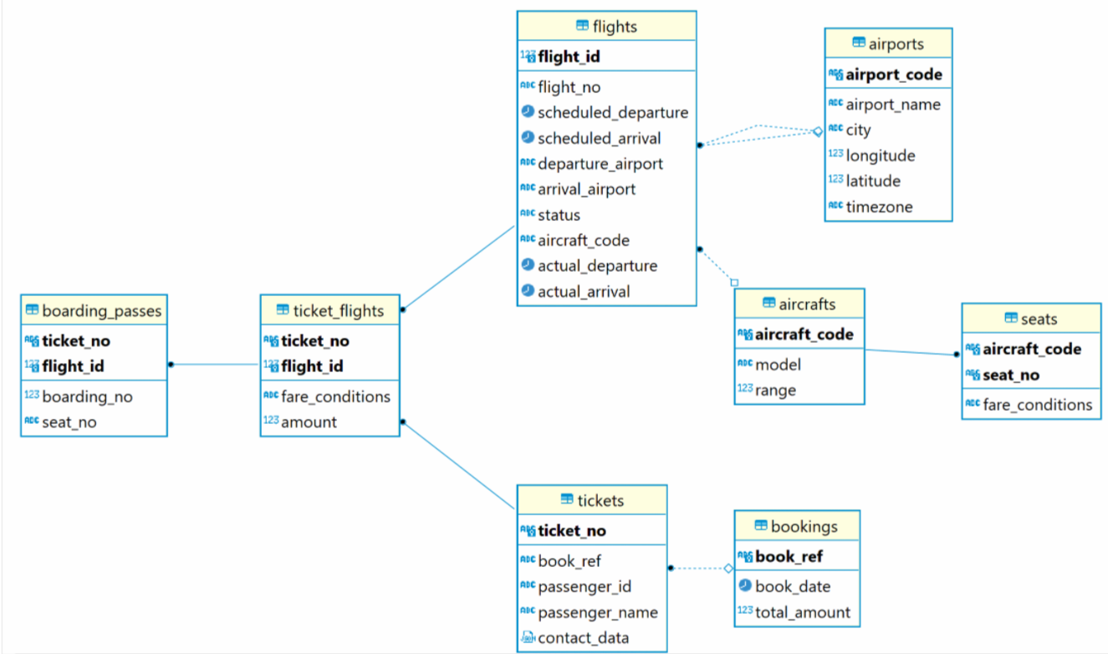
Data models
Conceptual data model: The most abstract data model that describes the data elements without much detail; mostly entities.
Logical data model: A conceptual model
with entities attributes and possibly more technical details
like data types.
Physical data model: A logical model with
all the details of the physical database (data types, constraints,
indexes, schemas, etc.) added.

Slide 3
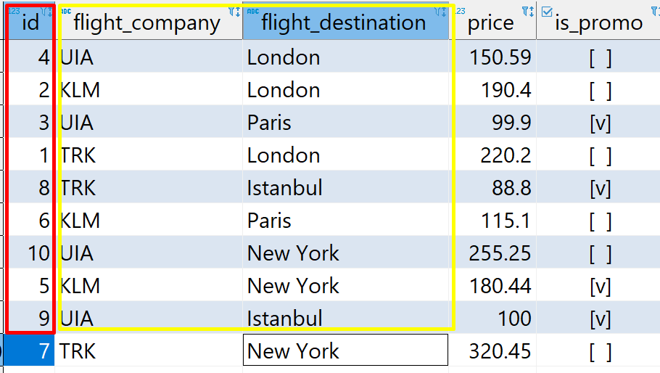
Primary Keys
The PRIMARY KEY (PK) constraint uniquely identifies each record in a table.
Primary key can consist of single or multiple columns (fields). Multiple columns PK is also called Composite PK.
A table can have only ONE primary key
Primary keys must contain UNIQUE values, and cannot contain NULL values
Primary key has its name and it is a database object, belonging to a table.
You can add PK while creating a table, or after, when you’re altering the table.
CREATE TABLE bookings.airports (
airport_code bpchar(3) NOT NULL,
airport_name text NOT NULL,
city text NOT NULL,
longitude float8 NOT NULL,
latitude float8 NOT NULL,
timezone text NOT NULL,
CONSTRAINT airports_pkey PRIMARY KEY (airport_code)
);
ALTER TABLE bookings.airports ADD CONSTRAINT airports_pkey PRIMARY KEY (airport_code);

Slide 4
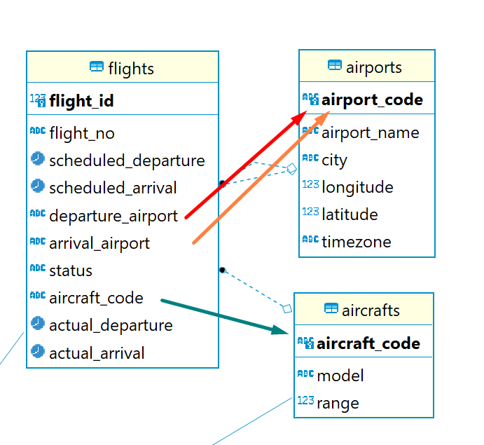
Foreign Keys
A FOREIGN KEY (FK) is a field (or collection of fields) in one table, that refers to the PRIMARY KEY in another table.
The table with the foreign key is called the child table, and the table with the primary key is called the referenced or parent table.
ALTER TABLE bookings.flights ADD CONSTRAINT flights_aircraft_code_fkey FOREIGN KEY (aircraft_code) REFERENCES bookings.aircrafts(aircraft_code);

Slide 5
Normalization/Denormalization
Database Normalization is a technique of organizing the data in the database. Normalization is a systematic approach of decomposing tables to eliminate data redundancy(repetition) and undesirable characteristics like Insertion, Update and Deletion Anomalies. It is a multi-step process that puts data into tabular form, removing duplicated data from the relation tables.
Denormalization is the reverse process to Normalization. Typically it’s used to speed up operations in reporting/analytical systems. Data can be duplicated across many tables but quite easier obtainable without complex joins.

Slide 6
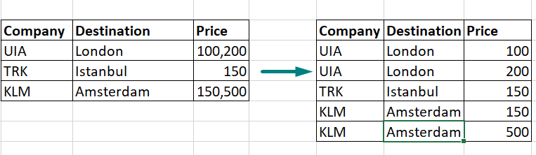
Normal forms: 1st
“Form of Homo Sapiens”
Single Valued Attributes
Attribute Domain should not change for single column
Unique name for Attributes/Columns
Order doesn't matter

Slide 7
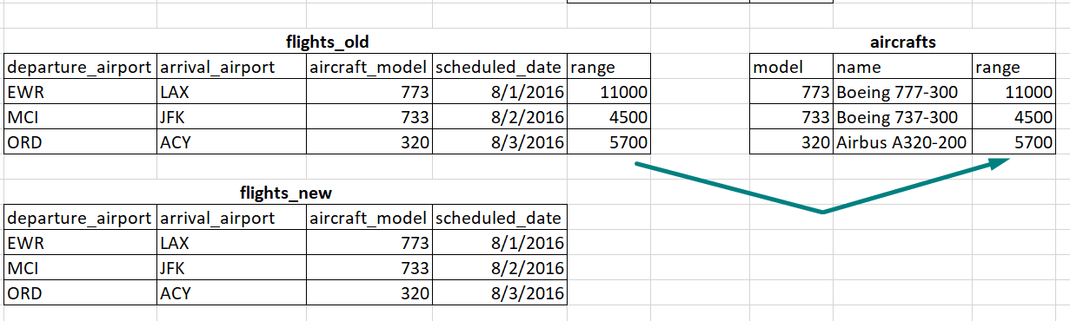
Normal forms: 2nd
The table should be in the First Normal Form.
There should be no Partial Dependency.
Partial Dependency exists, when for a composite primary key, any attribute in the table depends only on a part of the primary key and not on the complete primary key

Slide 8
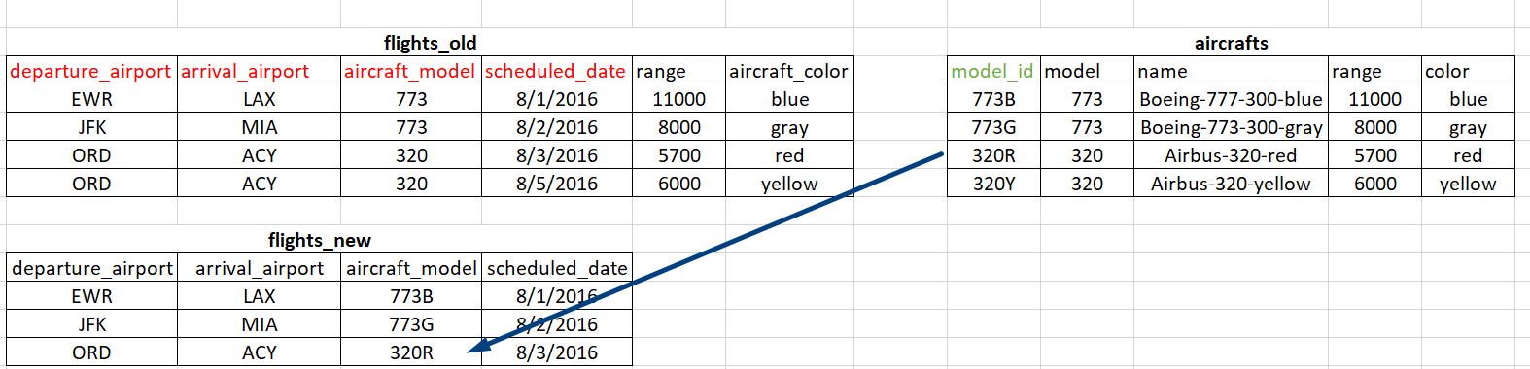
Normal forms: 3rd
The table should be in the Second Normal Form.
There should be no Transitive Dependency.
Transitive Dependency - when a non-prime attribute depends on other non-prime attributes rather than depending upon the prime attributes or primary key.

Slide 9
Other constraints
UNIQUE – provides values uniqueness for column(s). Unlike PK, there might be >1 UNIQUE constraints on a table
CONSTRAINT flights_flight_no_scheduled_departure_key UNIQUE (flight_no, scheduled_departure)
CHECK – each value of a column is checked for pre-defined condition: (un)equality, is value in some range etc.
CONSTRAINT flights_check CHECK ((scheduled_arrival > scheduled_departure))
alter table public.boryspil_flights add constraint id_check CHECK (id > 0);
alter table public.boryspil_flights add constraint flight_company_check CHECK (flight_company in ('UIA','KLM', 'TRK'));
DEFAULT – sets default value for a column.
alter table public.boryspil_flights add column departure_date date DEFAULT (now()::date);
alter table public.boryspil_flights alter column departure_date set DEFAULT '2000-01-01';
NOT NULL

Slide 10
Sequences
A sequence is a user-defined schema bound object that generates a sequence of numeric values according to the specification with which the sequence was created.
The sequence of numeric values is generated in an ascending or descending order at a defined interval and can be configured to restart (cycle) when exhausted.
1,2,3,4,5… 0,5,10,15, 0… 100,70,40,10,-20,-50…
How to create sequence:
Directly in DB
CREATE SEQUENCE my_seq START 100 INCREMENT BY 10 MAXVALUE 5000 CYCLE ON;
select nextval('my_seq');
--And then assign it to specific column
ALTER SEQUENCE my_seq OWNED BY my_table.my_id_column;
While creating a table, use pseudo-types serial/bigserial:
create table seq_test (id serial, some_text varchar);
insert into seq_test (some_text) values ('aaa'), ('bbb'), ('ccc');
select * from seq_test;

Slide 11
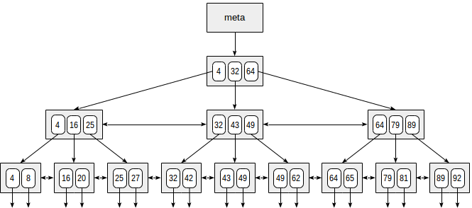
Indexes
An index is an on-disk structure associated with a table or view that speeds retrieval of rows from the table or view
Index can contain 1 or more columns
Most used is B-tree index (see picture below)
Index can be unique (in this case it acts as a constraint)
Keep in mind: indexes are not free! There’re costs to create and maintain them
Good candidates to include to index:
Columns often used in WHERE and ORDER BY clauses
Columns with high degree of uniqueness
Columns participated in JOINs
Syntax examples:
create index ix_flight_company
on public.boryspil_flights (flight_company);
CREATE UNIQUE INDEX flights_flight_no_scheduled_departure_key ON bookings.flights USING btree (flight_no, scheduled_departure);

Slide 12
Q&A/Homework
* - optional task
Create 2 tables:
2nd should have FK referring to PK in 1st
Both should have UNIQUE and CHECK constraints
Run some INSERT statements to test PK, FK, UNIQUE and CHECK constraints in these tables, observe the errors and understand them
2. At lection 3, slide 7 we created table public.b_el_paso_flights (if you didn’t, create it using script from there).
Add PK and index(es)
Add FK(s) referring to bookings schema
Explain your choice
*3. Take a look on transactions table:
Normalize it with assumptions:
- There’re thousands and millions of sales of thousands products, you see just a little sample
Expiration date is the same for the same product_id
If customer change its address, it treats like a new customer.
Provide DDLs (CREATE TABLE statements) for tables and explain your choice.
Fill tables with data and provide typical SELECT statement(s) which will obtain all the information above
product_id | product_name | product_supplier | price | expiration_date | transaction_date | quantity_sold | customer_name | customer_address | customer_level | price_sold
20 | H&S Shampoo | P&G | 128.5 | 4/5/2022 | 5/1/2021 | 3 | Miroslava | Svodoby 17 | Basic | 135
25 | Milka | Nestle | 41 | 7/6/2021 | 5/1/2021 | 50 | Ivan | Zelena 5 | Gold | 42.5
15 | iPhone 11 64 GB | Apple | 22500 | 10/7/2024 | 5/1/2021 | 2 | Olena | Chervona 7 | Silver | 24000
80 | Varvar Stout | Varvar | 55 | 10/8/2021 | 5/2/2021 | 24 | Oleksiy | Dubova 40 | Basic | 60
77 | iPad Pro 128 GB | Apple | 20000 | 1/9/2024 | 5/2/2021 | 1 | Petro | Kashtanova 1 | Silver | 21000
64 | Morshinska 1.5L green | IDS | 13.5 | 10/10/2021 | 5/1/2021 | 18 | Sergiy | Lisova 53 | Basic | 15
17 | Blend a med | P&G | 38 | 6/11/2021 | 5/2/2021 | 5 | Natalka | Svodoby 71 | Basic | 40
44 | Varvar IPA | Varvar | 50 | 10/12/2021 | 5/3/2021 | 20 | Vasyl | Platanova 4 | Gold | 55
56 | Q80T 55 inch TV | Samsung | 35000 | 5/1/2023 | 5/3/2021 | 1 | Solomiya | Bankova 16 | Silver | 37500
70 | Leleka Cabernet | Leleka Wines | 160 | 2/1/2022 | 5/1/2021 | 6 | Oleg | Sribna 31 | Basic | 175

Slide 13
Links to read
https://www.guru99.com/data-modelling-conceptual-logical.html
https://www.studytonight.com/dbms/database-normalization.php
And all sub-chapters about 1st, 2nd and 3rd normal forms
https://www.toptal.com/database/sql-indexes-explained-pt-1
https://www.toptal.com/database/sql-indexes-explained-pt-2
https://www.w3schools.com/sql/sql_constraints.asp
https://www.postgresql.org/docs/12/functions-sequence.html
https://www.postgresql.org/docs/12/sql-createsequence.html

